Slide 1
Turn Emotional Connections Into Assets that Never Stop
Council of Great City Schools PRE
July 9, 2017

Slide 2
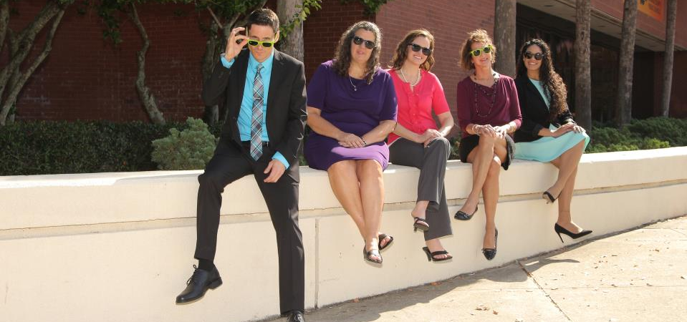
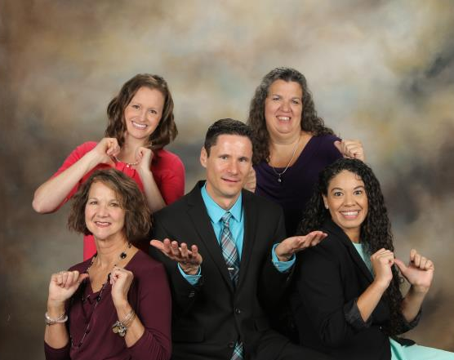

Slide 3
Counselor Time Spent on College Guidance
Public – 23% Private – 53%
Admission Rate to 4-year Colleges and Universities
Public – 49% Private – 95%

Slide 4
Public School
Private School

Slide 5
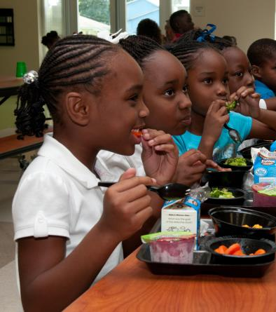

Slide 6
To Do
Ramp up student guidance services
Find your best stories and tell them repeatedly
Set a foundation for lifetime relationships

Slide 10
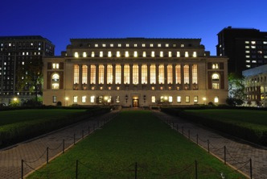
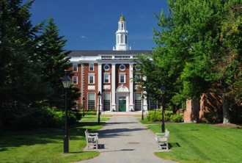
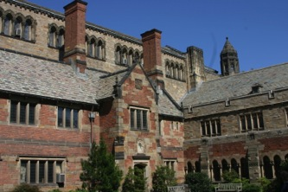
OCPS Super Scholars
113 graduates accepted by Elite Colleges & Universities
Princeton, Harvard, Yale, Columbia, Stanford, Chicago, MIT, Duke, Penn, Cal Tech, Dartmouth, Johns Hopkins, Northwestern, Emory, Washington University at St. Louis, Cornell, Brown, Notre Dame, Vanderbilt, Rice, UC/Berkeley, Williams, Amherst, Swarthmore, Wellesley, Bowdoin, Pomona, Middlebury, Carleton, Claremont McKenna, Haverford, Davidson, Vassar, Naval Academy, Washington & Lee, Colby, Colgate, Hamilton, Harvey Mudd, Smith, Wesleyan, Grinnell, West Point, Air Force Academy, Coast Guard Academy, Merchant Marine Academy
Notes:
Last year, 85 graduating seniors from the class of 2015 were accepted into America’s top-20 lists of universities, liberal-arts colleges, and military academies as ranked by US News and World Report.

Slide 11
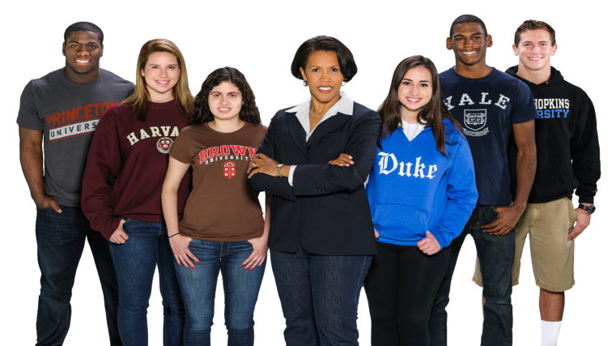

Slide 13
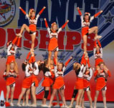
Alumni Capital Campaigns
Scoreboards, Flight Simulators, Uniforms, etc.

Slide 14
The Class Connector

